Slide 1
Temporal Logic For Anomaly Detection In Traffic Videos
CS599 Final Project Nicole Fronda

Slide 2
Agenda
Background
Problem Setup
Implementation
Results
Conclusion

Slide 3
Background

Slide 4
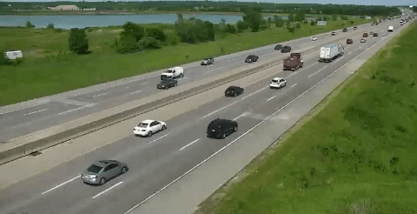
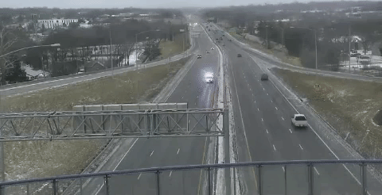
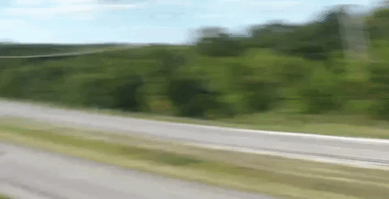
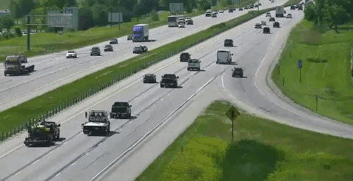
NVIDIA AI City Challenge - Anomaly Detection
Notes:
ADD MORE EXAMPLES?
The ambulance
Car going into lane in 33?
Camera shift?

Slide 5
Problem Setup

Slide 6
Pipeline
Annotate Videos
Identify and Label Vehicles in Video Frames
Identify Road Lanes
Calculate Car Velocities
Create Traces
Develop Signal Temporal Logic Rules to Detect Anomalies
Project Traces Through Signal Temporal Logic Rules
Cluster Traces
Identify Anomalous Clusters

Slide 7
Pipeline
Annotate Videos
Identify and Label Vehicles in Video Frames
Identify Road Lanes
Calculate Car Velocities
Create Traces
Develop Signal Temporal Logic Rules to Detect Anomalies
Project Traces Through Signal Temporal Logic Rules
Cluster Traces
Identify Anomalous Clusters

Slide 8
Anomalies
Cars moving faster than average
Cars moving slower than average
Cars suddenly braking
Cars suddenly accelerating
Cars parked in the shoulder
Notes:
Show rules in Temporal Logic and in English and maybe with pictures
In the next slides I’ll go over how I translated these anomalies from plain English to an STL formula

Slide 9
Anomalies in Signal Temporal Logic
Cars moving faster than average
F ((v[t] – avg_v) > C)
Look for signal clusters with really high C
Clusters with really low C are cars moving slower than average
C
Potential anomaly
t
Notes:
Eventually the velocity for a car at time t minus the average velocity of all cars in the video is greater than some C
Show rules in Temporal Logic and in English and maybe with pictures

Slide 10
Anomalies in Signal Temporal Logic
Cars moving slower than average
F ((avg_v - v[t]) > C)
Look for signal clusters with really high C
Clusters with really low C are cars moving faster than average
C
Potential anomaly
t
Notes:
Show rules in Temporal Logic and in English and maybe with pictures

Slide 11
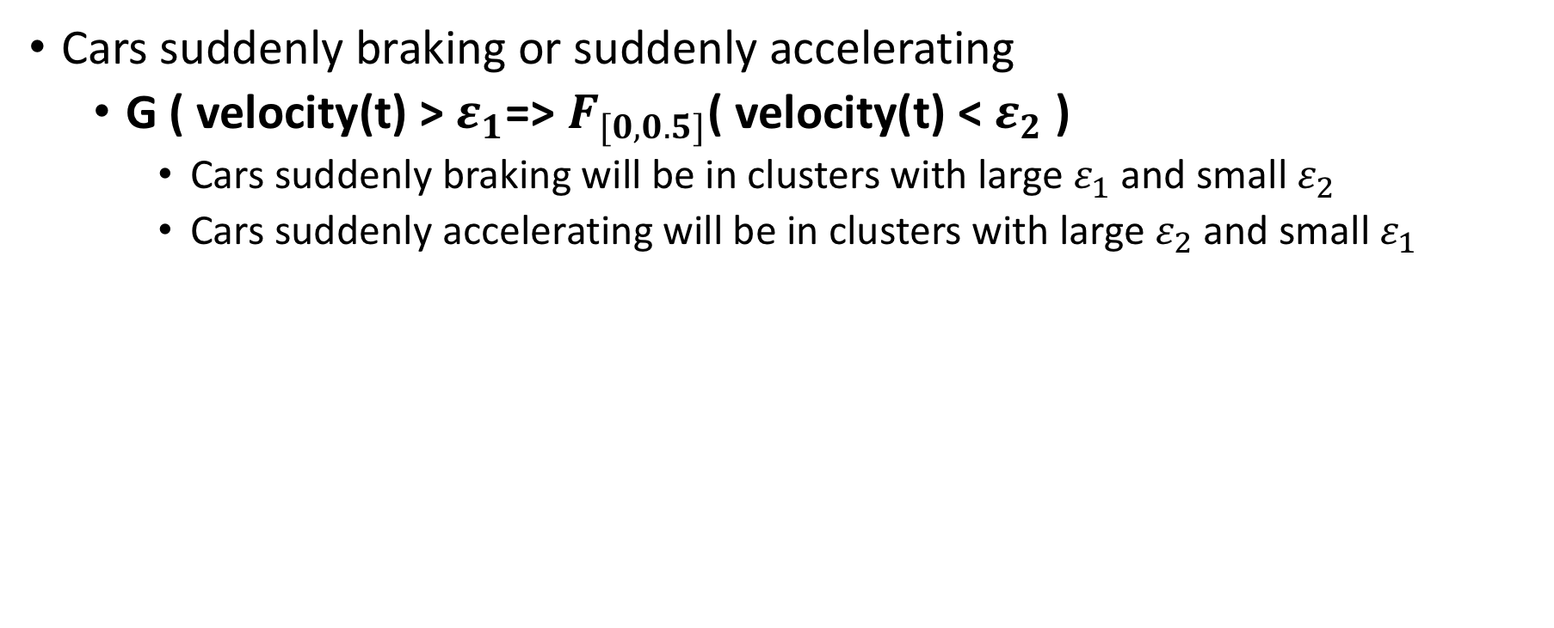
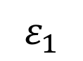
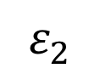
Anomalies in Signal Temporal Logic
Cars suddenly braking or suddenly accelerating
G ( velocity(t) > $ε_{1}$=> $F_{[0, 0.5]}$( velocity(t) < $ε_{2}$ )
Cars suddenly braking will be in clusters with large $ε_{1}$ and small $ε_{2}$
Cars suddenly accelerating will be in clusters with large $ε_{2}$ and small $ε_{1}$
$$ε_{2}$$
$$ε_{1}$$
Notes:
Globally, if the velocity at time t for car is greater than some epsilon 1, this implies that eventually, in the next time step the velocity is less than some epsilon 2
Cars suddenly braking – bottom right
Cars suddenly accelerating = top left
Show rules in Temporal Logic and in English and maybe with pictures

Slide 12
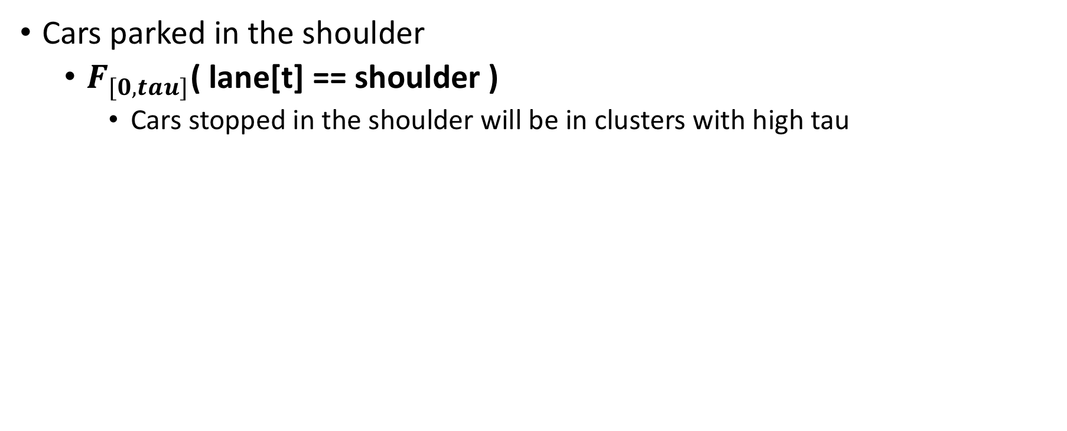
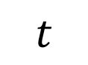
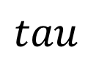
Anomalies in Signal Temporal Logic
Cars parked in the shoulder
$F_{[0, tau]}$( lane[t] == shoulder )
Cars stopped in the shoulder will be in clusters with high tau
$$tau$$
$$t$$
Notes:
Show rules in Temporal Logic and in English and maybe with pictures

Slide 13
Implementation

Slide 14
Pipeline
Annotate Videos
Identify and Label Vehicles in Video Frames
Identify Road Lanes
Calculate Car Velocities
Create Traces
Develop Signal Temporal Logic Rules to Detect Anomalies
Project Traces Through Signal Temporal Logic Rules
Cluster Traces
Identify Anomalous Clusters

Slide 15
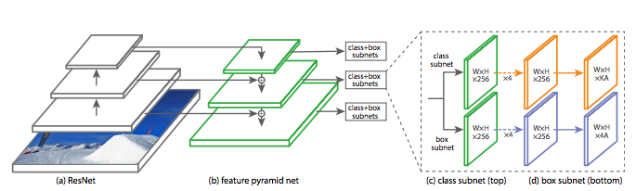
Annotate Videos: Identify Vehicles
2 Stage Neural Network
Focal Loss for Dense Object Detection
Notes:
2 –stage network : similar to R-CNN or Fast R-CNN
Residual Net -> convolution feature map of the image
Feature Pyramid Network -> augments the convolution net of the ResNet. Each level of the pyramid can be used for detecting objects at a different scale.
Create Anchor Boxes within the image
Classification -> The classification subnet predicts the probability of object presence at each spatial position for each of the A anchors and K object classes.
Box Regression Subnet -> regress from the anchor box to the actual object
NOTE: The code implementation for this was done primarily by one of my project partners. But moving forward, I’ll be discussing my own contributions to the projection.

Slide 16
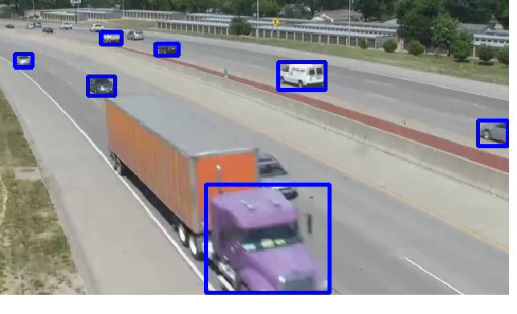
Annotate Videos: Label Vehicles
Notes:
Network outputs positions and dimensions of the bounding boxes in the frame where cars/trucks are
Does this on a frame by frame basis, so it doesn’t keep track of positions of cars in the previous frame

Slide 17
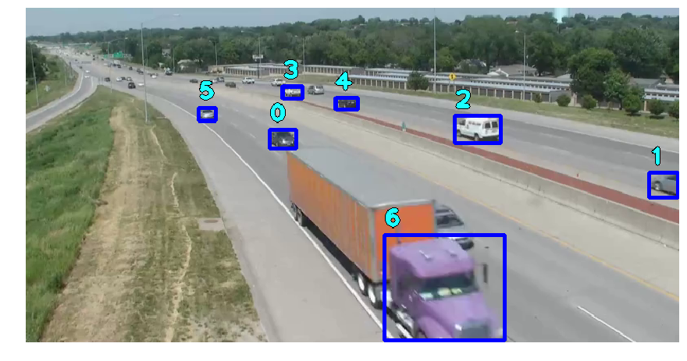
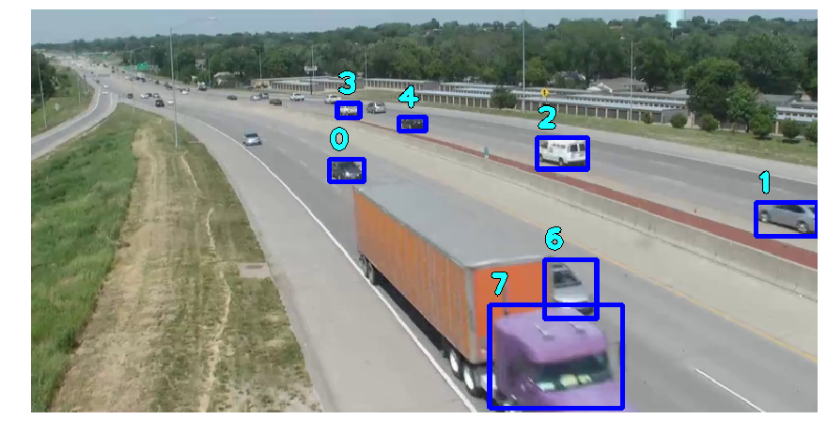
Annotate Videos: Label Vehicles
previous_positions = {}
for f in frames:
for car in f:
closest_car = find_closest(car(x, y), previous_positions)
if there is no closest_car:
add new car to previous_positions
else:
update previous position of car
Previous_positions = {c0 : [(x1, y1), (x2, y2)], c1 : [(x1, y1), (x2,y2)],
…
c5 : [(x1, y1)],
c6 : [(x1, y1), (x2, y2)],
c7 : [(xy, y2)]}
Notes:
To label each bounding box with unique ids
Keep track of the previous position of all cars in the last frame of the video, in an array
For each car identified in the next frame, find the closest bounding box out of the list of previous positions
If it can’t find the previous position -> it’s a new car coming into the view of the camera
Otherwise -> update the car’s position
Add pseudo code for identify vehicles frame by frame

Slide 18
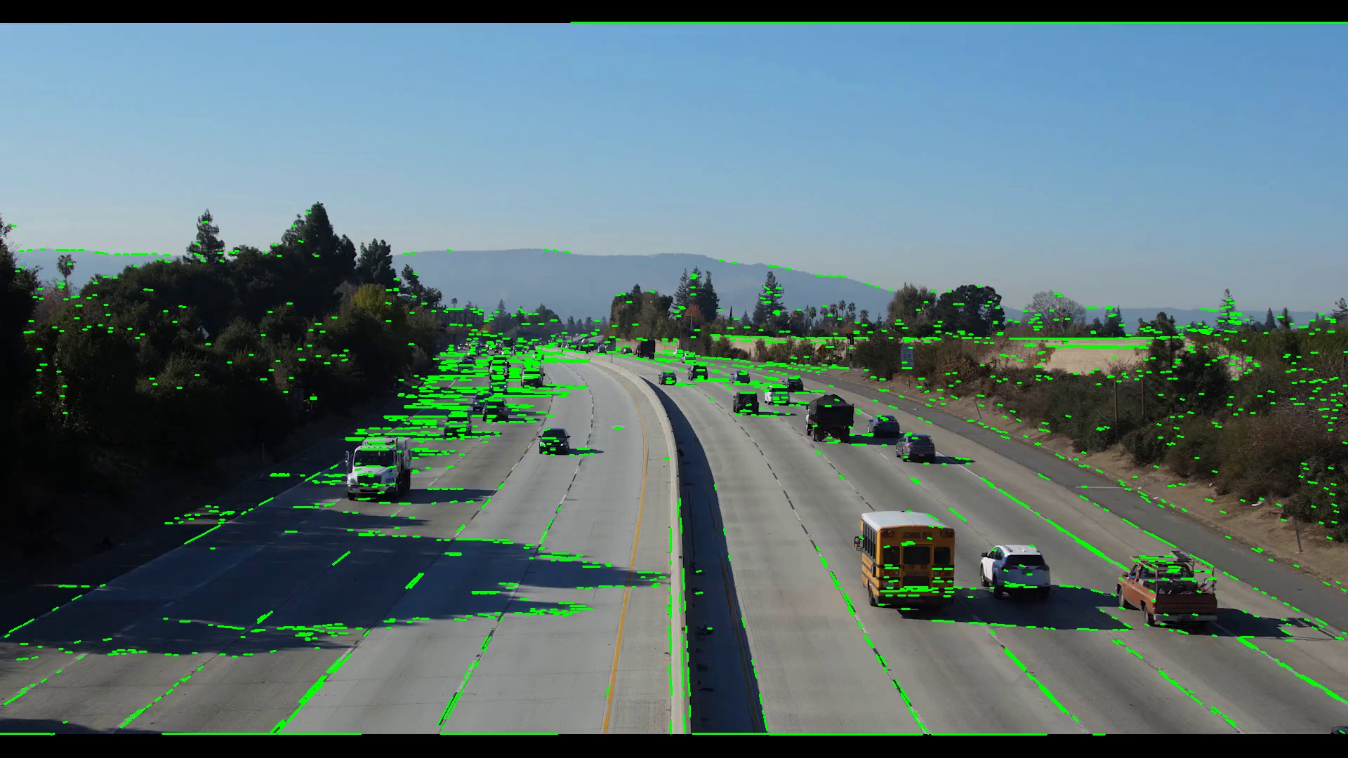
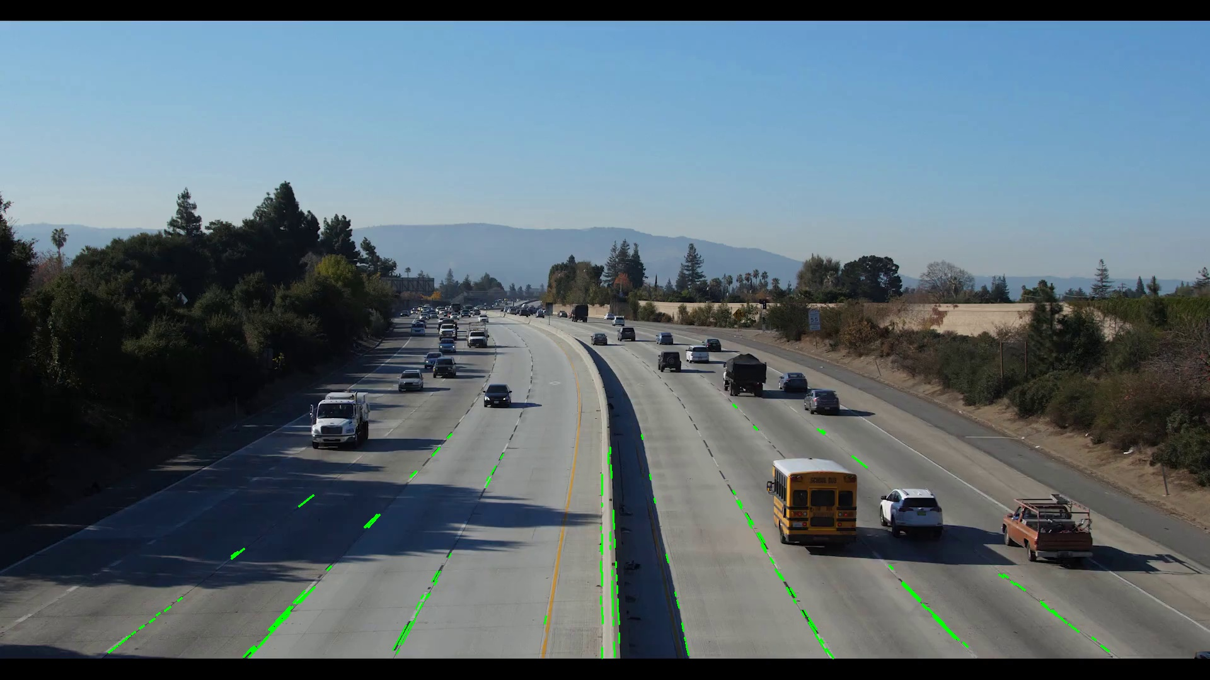
Annotate Videos: Identify Road Lanes
Canny Edge Detection
Hough Transform
Notes:
Explain how Canny and Hough transformed used to find lanes
Canny Edge Detection:
Apply Gaussian filter to smooth the image in order to remove the noise
Find the intensity gradients of the image
Apply non-maximum suppression EDGE THINNING technique to get rid of spurious response to edge detection
Apply double threshold to determine potential edges
Track edge by hysteresis: Finalize the detection of edges by suppressing all the other edges that are weak and not connected to strong edges.
Hough Transform to keep only the edges that are a certain angle

Slide 19
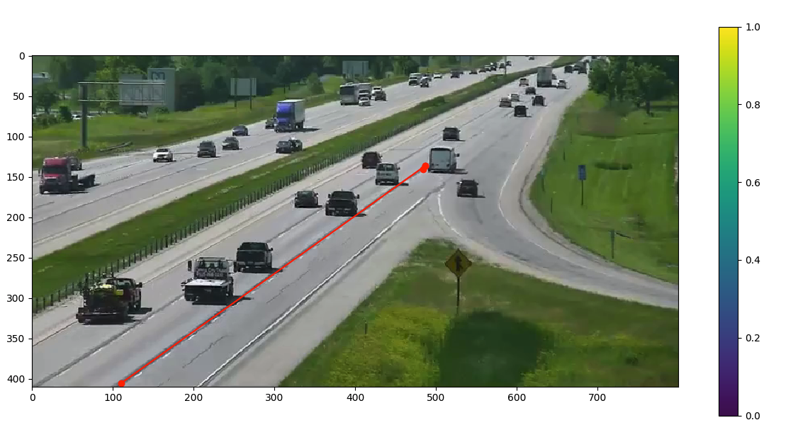
Annotate Videos: Identify Road Lanes (alternative solution)
Notes:
Previous method did not work well for the picture quality of some videos
As an alternative solution for those cases, I built a simple tool that allowed us to manually annotate the videos
Explain Alternative Solution in how you Build Tool to Draw Road Lanes
Show pictures of tool

Slide 20
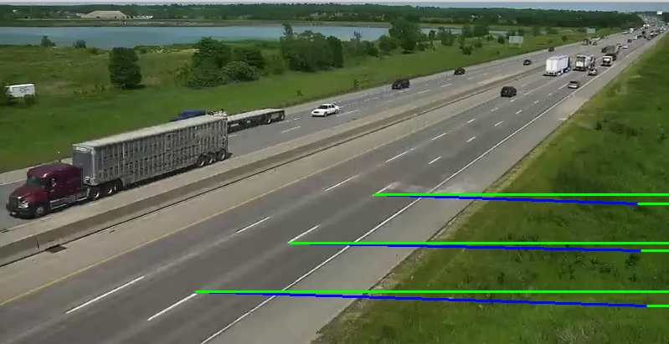
Annotate Videos: Calculate Velocity
N = # frames between A and B
dist = actual distance between A and B
V = dist / ( N / 30 fps)
B
A
Notes:
Use Pictures and Formula to calculate velocity from the drawn fixed points
Count number of frames a car would take to get from A to B
A to B defined by the edge of the road lanes
Made assumption that:
Distance of white lines – 10ft
Distance between white lines = 30 ft

Slide 21
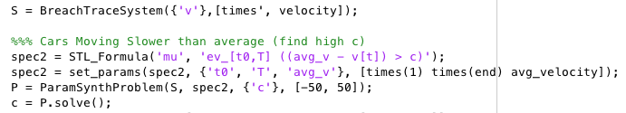
Project Traces Through Signal Temporal Logic
Notes:
After all those annotations, we obtained traces for each vehicle's velocity and lane position
I then implemented the STL formulas shown earlier in MATLAB
and projected each of the traces through each of the STL formulas

Slide 22
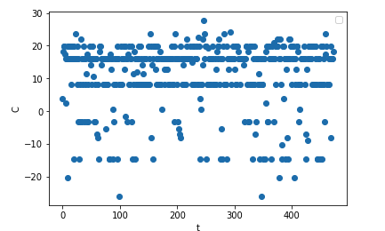
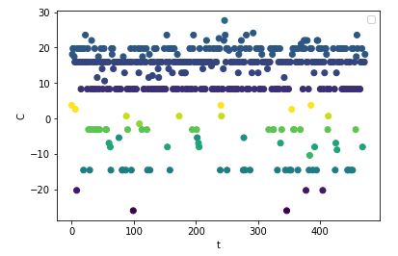
Cluster Traces & Identify Anomalous Clusters
Notes:
On the left is the result of projecting the traces through the STL formulas
On the right are the different clusters of traces
Use the Agglomerative method Hierarchical Clustering
Greedy approach to merge close points together
This is a "bottom up" approach: each observation starts in its own cluster, and pairs of clusters are merged as one moves up the hierarchy.
Criterion for clustering is distance

Slide 23
Results

Slide 24
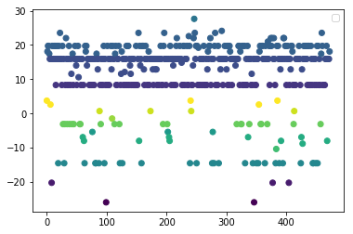
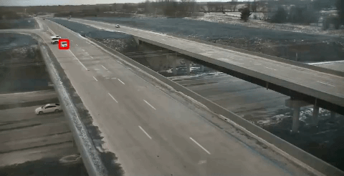
Cars Moving Slower Than Average
F ((avg_v - v[t]) > C)
Notes:
An example of a car moving slower than average and almost causing a collision with the car behind it, causing that car to cross the solid white line and drive around it

Slide 25
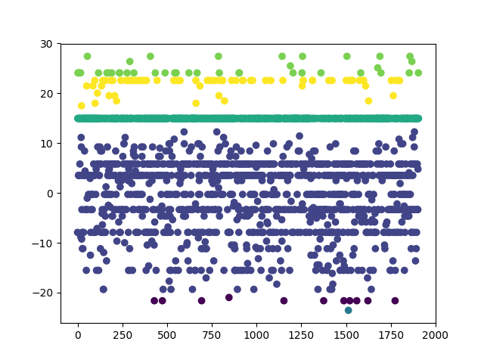
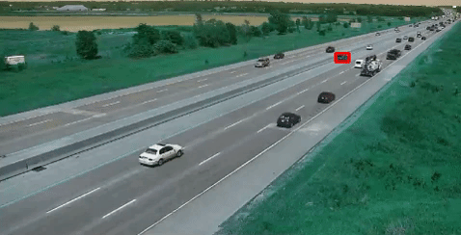
Cars Moving Slower Than Average
F ((v[t] – avg_v) > C)
Notes:
Another car that’s moving slower than average – it’s actually completely stopped – but this was identified by the opposite formula of the one previously

Slide 26
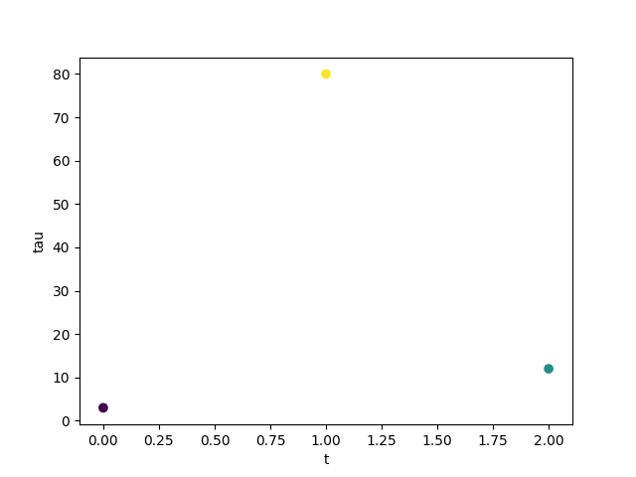
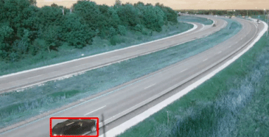
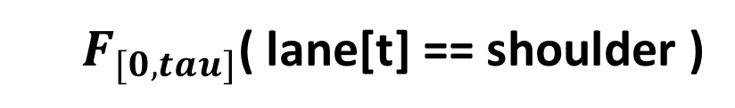
Cars parked in the shoulder
$F_{[0, tau]}$( lane[t] == shoulder )
Notes:
Car driving onto the shoulder

Slide 27
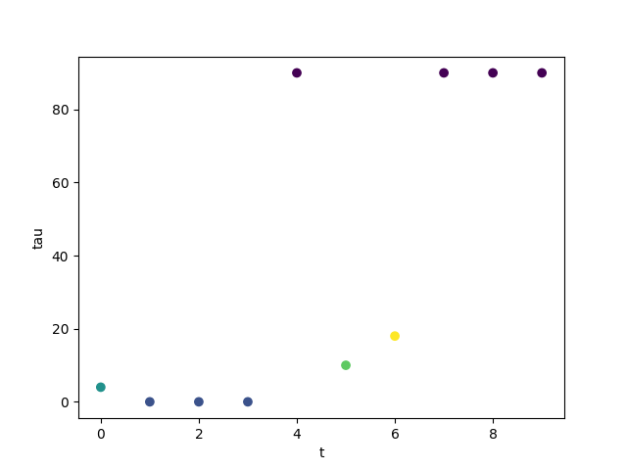
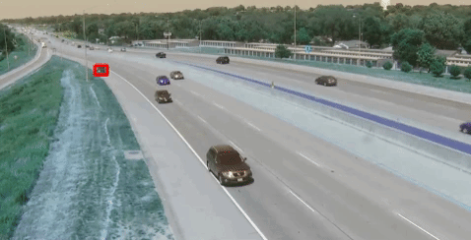
Cars parked in the shoulder
$F_{[0, tau]}$( lane[t] == shoulder )
Notes:
Another car driving onto the shoulder

Slide 28
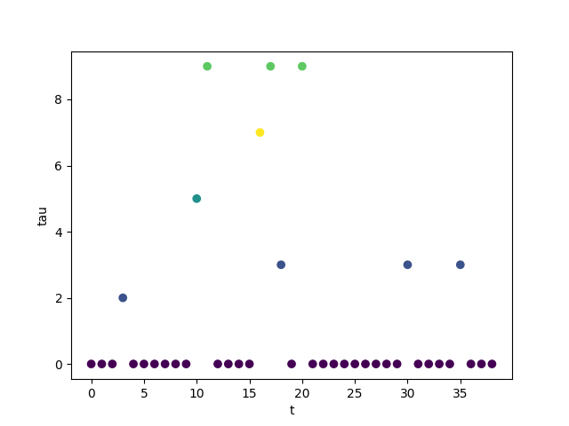
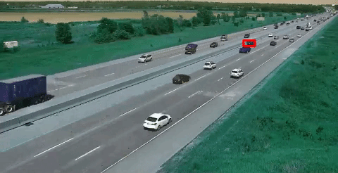
Cars parked in the shoulder
$F_{[0, tau]}$( lane[t] == shoulder )
Notes:
Another car driving onto the shoulder. This is actually the same car identified a couple slides ago, but at a different time in the video

Slide 29
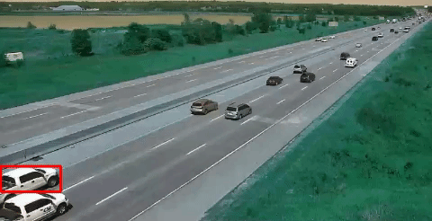
False Positives
$F_{[0, tau]}$( lane[t] == shoulder )
Notes:
Car looks like it might be in the shoulder from the way the bounding box is positioned, but it’s not. It’s projected ‘tau’ value is actually higher than the car identified in the last slide

Slide 30
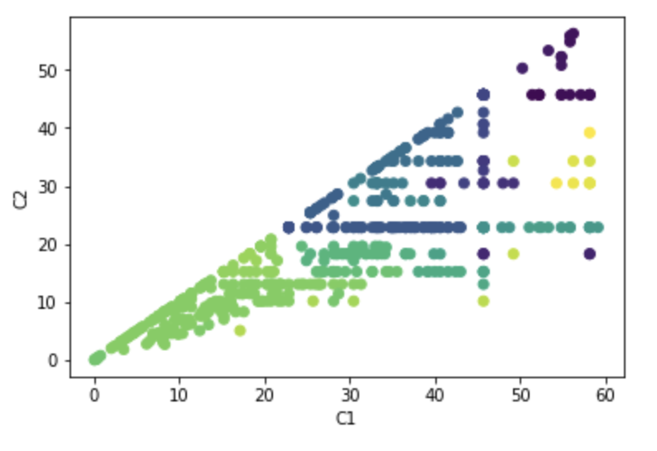
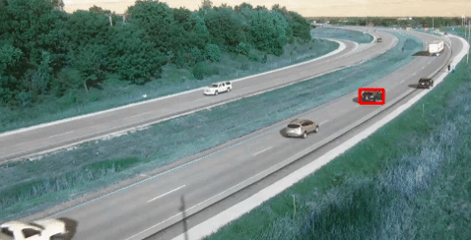
False Positives
G ( velocity(t) > $ε_{1}$=> $F_{[0, 0.5]}$( velocity(t) < $ε_{2}$ )
Notes:
Car suddenly slowing down, as appropriate because there's stopped traffic on the side of the road. So the logic is correct here, but it's not actually an anomaly

Slide 31
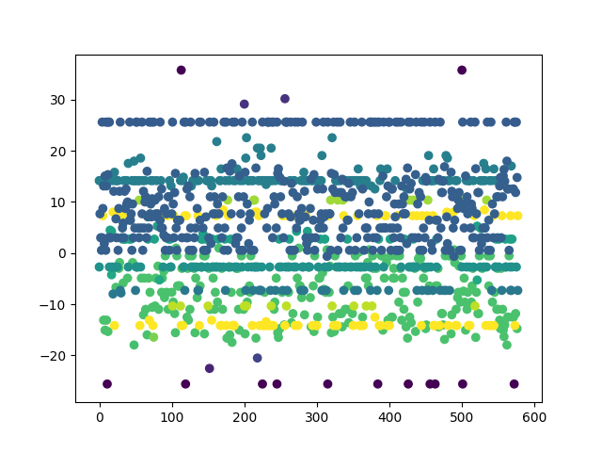
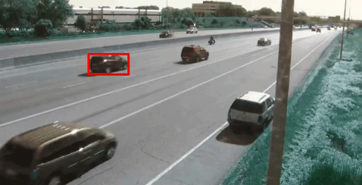
False Positives
F ((avg_v - v[t]) > C)
Notes:
Similar case here, this car looks like it's moving faster than average than the car next to it, but it’s not anomalous behavior
On the right, could not identify car at all because of the obscured pole

Slide 32
Time of Detection
Anomaly Detected: 10:47
Actual Start Time: 9:39
Notes:
In terms of timing of when these anomalies were detected, here’s a case where it was only identified almost 1 minute later

Slide 33
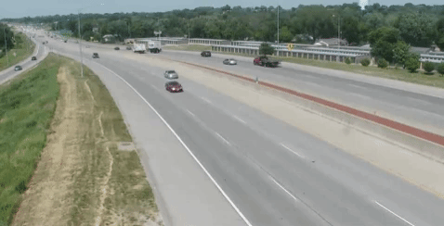
Time of Detection
Anomaly Detected: 5:07
Actual Start Time: 4:50
Notes:
This is a little better on timing, only 17 seconds late

Slide 34
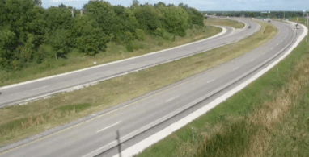
Time of Detection
Anomaly Detected: 6:56
Actual Start Time: 6:55
Notes:
But for the most part timing was dead on. Here’s a case where it was only 1 second off

Slide 35
Overall Results
Small Sample Size:
20 videos
8 Anomalies
5 Anomalies Detected
Precision: 13%
Recall: 63%
RMSE Time of Detection: 31.7

Slide 36
Conclusion

Slide 37
Accomplishments and Areas of Improvement
Neural Network for Object Detection
Lane Detection with Computer Vision
Improvements for better Anomaly Detection
Fine Tune Object Detection and Labeling
Improving techniques for automatically finding regions of interest
Notes:
Regions of interest examples (lanes, lane markings, shoulders)

Slide 38
Future Work
More STL rules
Build a Neural Network to Detect Anomalies and use STL to evaluate
Build a model to work in real time

Slide 39
Q&A
https://github.com/nicaless/cs599_project

